Slide 1
DAAP Technical Writing – Quick Start
Q2 2023f

Slide 2

Agenda
Technical Communication Overview
Technical Documents Types
Technical Document Components
The 5 Cs: Clear, Concise, Complete, Consistent, Compliant
Document Lifecycle
Demo
Q&A

Slide 3

What is Technical Communication?
A means to convey
scientific, engineering, or other technical information.

Slide 4



Benefits
Leadership
Create governance & accountability
Increase transparency
Build trust & partnerships throughout enterprise / Industry
Customer Satisfaction & Support
Products & Teams
Encourage self-sufficiency
Enable user support team
Build knowledge-sharing tools
Build trust & partnerships with users
Promote re-use of tools, APIs, & code
Help users stay on task/ less time troubleshooting
Strengthen product value to Company & industry
Increase traffic to product / website
Increase word-of-mouth marketing
Return better feedback from users
Establish best practices
Improve data integrity
Promote team & company alignment
Mitigate change management
Help process adoption
Grow collaboration & innovation
Reduce frustration & confusion
Onboard new hires
Technical Communication:

Slide 5
Document Types: “What” – oriented
What is it?
What does it do?
Benefits & incentives?
Terms & definitions?
Examples:
Company Policies
Product Overviews
Release Notes
Marketing & Sales Docs
The What

Slide 6
Document Types: “How” – oriented
Examples:
API & SDK Docs
User Guides
Job Aids
Business Continuity plans
Step-by-step instructions
Screenshots, code blocks, examples & infographics
The How

Slide 7
Document Types: “Learning” – oriented
Examples:
Tutorial videos
Training modules
FAQs
Knowledgebase
User Support manuals
The Learning
Teaching & training tools
Change Management
Process adoption

Slide 8
Document Components:
Connects to docs with similar topics
Lists important sites & tools
Links to support channels
Names of SMEs / contacts
Opportunities to provide feedback
Resources
Introduces topic
Sets expectations
Names requirements
Introduction
Version #, date, author, description
Offers the what & why
Version History
Informs (the What)
Provides instructions (the How)
“Trigger to Target”
Screens, code block, graphics
Body
Technical Communication Training 2023

Slide 9
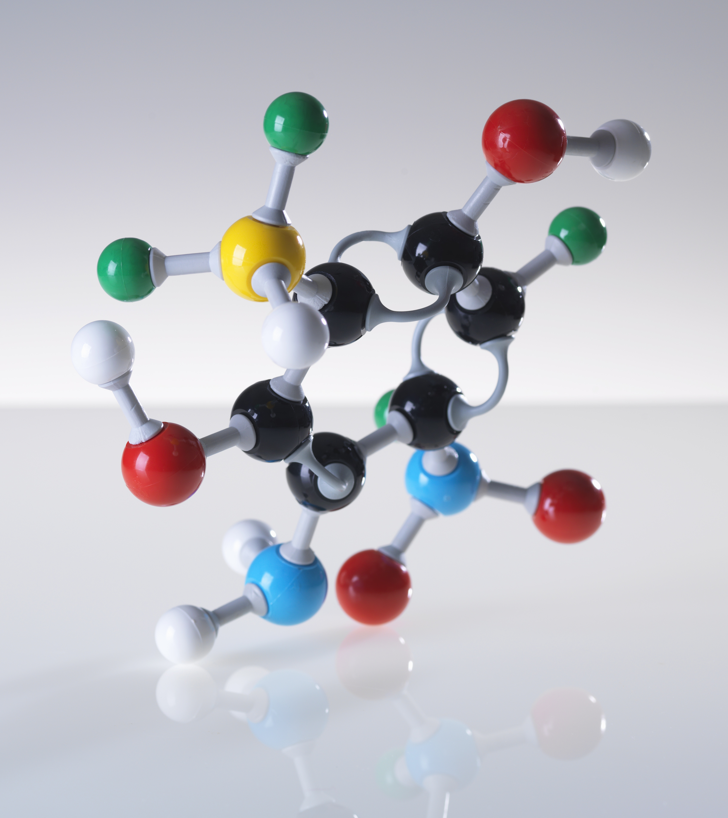
Clear
Concise
5 Cs of
Tech Writing
Complete
Consistent
Compliant

Slide 10

Clear
Ensure readers understand information & instructions:
Choose words deliberately
Use proper grammar
Define unfamiliar terms
Do not use acronyms & abbreviations
Avoid jargon
Be Accessibility conscious
Clear
Concise
Complete
Consistent
Compliant

Slide 11

Concise
Embrace simple – Less is more
Keep words & sentences short
Write in Active voice (start with a verb)
Use present tense
Eliminate extra nouns & filler words
Focus on topic to reduce scope creep
Clear
Concise
Complete
Consistent
Compliant

Slide 12

Complete
Create a comprehensive package
Think in terms of “Trigger to Target” –
What Triggers the Action? What is the targeted Outcome?
Avoid assumptions with reader knowledge & understanding (“Lottery doc”)
Find balance between Concise & Complete with links to FAQs, training modules, & tutorials
Clear
Concise
Complete
Consistent
Compliant
Technical Communication Training 2023

Slide 13

Consistent
Unlock clarity with consistency
Use consistent fonts, bulleting, colors, templates (style guide)
Write with uniform grammar and tone (Active voice)
Use industry-familiar terms & avoid over interchange
Reuse product language, designs, & graphics
Clear
Concise
Complete
Consistent
Compliant

Slide 14

Compliant
Adhere to technical writing best practices
Respect established standard operating procedures
Follow determined style guide & templates
Be 508 conscious (Accessibility)
Consider company, local, state, & federal regulations
Clear
Concise
Complete
Consistent
Compliant
Technical Communication Training 2023

Slide 15


Document Lifecycle
6. Compile & complete feedback
8. Final review & testing
5. Submit doc for stakeholder review
9. Complete v.1
4. Work with SME to gap fill
10. Move to master
branch of repo
3. Research & create rough draft
2. Prioritize & track request
11. Review for template compliance & update
1. Receive request & basic Info
12. Allow AE team to copy doc into CMS
13. Approve AE pull request
14. Publish document to Data & Analytics Portal CMS for consumption*
15. User feedback & iteration
Technical Communication Training 2023

Slide 16

Q & A
Related Documents
Technical Writing Template
Technical Writing Checklist
Technical Writing How-to Guide
Technical Writing Style Guide
Related Links
508 conscious
Technical Communication Training 2023

